Slide 2
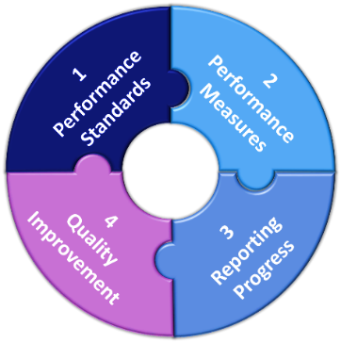

[Describe the group who is primarily responsible for performance management in the organization, such as a Performance Management Committee]
[List committee members and contact information here]
Embracing Quality in Public Health: A Practitioner’s Performance Management Primer Online Training: https://pmqitraining.miophi.org/
[List links of resources and training that your agency uses here]
The Performance Management Plan is located here: [List the link to your performance management plan here]
Performance Management Measures tracking tool is located here: [List the link to your performance management tracking tool here]
Performance Management Reports are shared:
When: [Include a description of when your performance management reports are shared]
Where: [List where your reports are shared and include any links if available]
Staff can be involved by:
[List ways staff can be involved with the performance management process in your agency]

